Slide 1

Conservation science (196.315) Reserve selection
Jeffrey Hanson

Slide 2
Now
Biodiversity
Status quo
2000
Future

Slide 3
Now
How do we
bend the curve ?
Biodiversity
Status quo
2000
Future

Slide 4
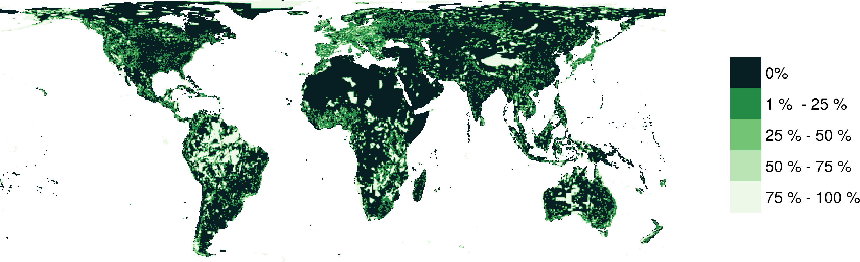
Protected areas

Slide 5



How do we bend the curve?
Ecological surveys
Distribution maps
Priority areas
Biodiversity
2000
Future
Data
Information
Plan
Outcome

Slide 6
How do we bend the curve?
Ecological surveys
Distribution maps
Priority areas
Biodiversity
2000
Future
Data
Information
Plan
Outcome
Prioritization

Slide 7
Reserve selection
Features
Notes:
- not all remaining habitat can be preserved
- achieve conservation objectives for minimal cost
- modern systematic conservation planning primarily focusses on representing species
- however, this ignores intra-specific biodiversity

Slide 8
Reserve selection
Planning
units

Slide 9
Reserve selection
?
?
?
?
?
?

Slide 10
Systematic conservation planning
“Systematic conservation planning aims to provide a rigorous, repeatable, and structured approach for designing new protected areas that efficiently meet conservation objectives”
Schuster et al. (2020) PeerJ, DOI:10.7717/peerj.9258

Slide 11

CARE Principles
Comprehensive
Adequate
Representative
Efficient
Kukkala & Moilanen (2013) Biol Rev, doi:10.1111/brv.12008

Slide 12

CARE Principles
Comprehensive
Adequate
Representative
Efficient
versus

Slide 13
CARE Principles
Comprehensive
Adequate
Representative
Efficient
versus

Slide 14
CARE Principles
Comprehensive
Adequate
Representative
Efficient
versus

Slide 15
CARE Principles
Comprehensive
Adequate
Representative
Efficient
versus

Slide 16
Connectivity
“improve population resilience to disturbance, increase metapopulation viability, promote genetic diversity and maintain energetic pathways among ecosystems”
Within-reserve connectivity
Daigle et al. (2020) Methods Ecol Evol, DOI:10.1111/2041-210X.13349

Slide 17
Connectivity
“improve population resilience to disturbance, increase metapopulation viability, promote genetic diversity and maintain energetic pathways among ecosystems”
Between-reserve connectivity
Highway
Daigle et al. (2020) Methods Ecol Evol, DOI:10.1111/2041-210X.13349

Slide 18
Principle complementarity
Protected areas should “complement” each other to maximize the performance of the overall protected area network (including. existing protected areas)
Vane-Wright et al. (1991) Biol Cons, DOI:10.1016/0006-3207(91)90030-D

Slide 19
Reserve selection
?
?
?
?
?
?

Slide 20
Reserve selection

Slide 21

But why?
Comprehensive
Adequate*
Representative**
Efficient
Connectivity***
Principle complementarity
*Assuming each species only needs 1 cell
***Assuming species can disperse
throughout entire landscape
**Assuming no significant intra-specific variation

Slide 22
Representation targets
Policy
“In 1992, the Fourth World Congress on National Parks and Protected Areas [recommended] “that protected areas cover at least 10 percent of each biome by the year 2000” (McNeely 1993).”
“[Aichi target 11] […] targets mandate that 17% of terrestrial areas, and 10% of coastal and marine areas should be covered by nature conservation networks […]”
Policy
“We set as a fixed target the conservation of at least 10% of grid cells occupied by a species, with a minimum of one.”
“As a habitat-specific target, we used 17% of the total number of PUs where the respective habitat occurs, adopting Aichi target 11 “
Targets
Friedrichs et al. (2018) Plos ONE, DOI:10.1371/journal.pone.0208264
Jetz et al. (2014) Current Biol, DOI:10.1016/j.cub.2014.03.011
Brooks et al. (2004) BioScience, DOI:10.1641/0006-3568(2004)054[1081:CPBTGP]2.0.CO;2

Slide 23
Representation targets
Statistical estimates/models
“We modelled […] scenarios based on […] the [population viability analysis] by Todd et al. (2016). The reserve scenarios were based on the protected area required to achieve a less than 5% chance of the Leadbeater’s Possum population falling to (or below) 500 or fewer adult females in 40 generations […]. [The worst case scenario] required the Leadbeater’s Possum reserve to be expanded to 171,345 ha.”
“We aimed to include 30% of each biodiversity feature [e.g. vegetation types, environmental domains, species distributions] while minimizing the economic cost of the system of selected areas. We set conservation targets for each feature at 30% of their pre-clearing (year 1770) extent to be consistent with international recommendations (IUCN, 2003) and to ensure that biodiversity features are represented in proportion to their natural extent”
Klein et al. (2009) Biol Cons, DOI:10.1016/j.biocon.2009.01.035
Taylor et al. (2017) Plos ONE, DOI:10.1371/journal.pone.0169629

Slide 24
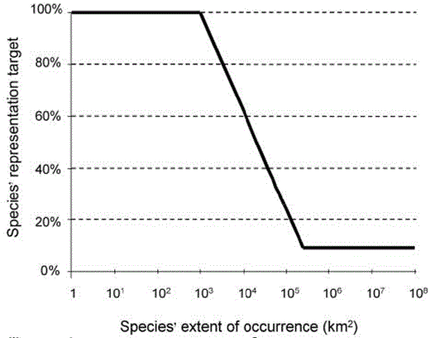
Representation targets
Expert thresholds
“Species into as many biodiversity features as the biomes in which the species occurs. We set species targets to conserving the minimum amount of species’ habitat necessary to qualify it for the conservation status ‘Least Concern’ following IUCN Red List criteria”
Jung et al. (2021) Nat Ecol Evol DO:10.1038/s41559-021-01528-7
Rodrigues et al. (2004), BioSicence, DOI:
10.1641/0006-568(2004)054[1092:GGAPRF]2.0.CO;2

Slide 25
Framing conservation as a decision science problem
Goal: what is our vision for the future?
Objective: what quantity are we maximizing/minimizing to achieve the goal?
Constraints: what must things must we account for when implementing different actions?
Decisions: what actions can we implement to achieve our objective?

Slide 26
Framing conservation as a decision science problem
Goal: what is our vision for the future?
Objective: what quantity are we maximizing/minimizing to achieve the goal?
Constraints: what must things must we account for when implementing different actions?
Decisions: what actions can we implement to achieve our objective?

Slide 27




Reserve selection as optimization
Goal: conserve biodiversity
Objective: min. # of islands
Constraints: sufficient habitat for each species (≥ 1 island per species)
Decisions: create a reserve on an island or not?

Slide 28
Reserve selection as optimization
Goal: conserve biodiversity
Objective: min. # of islands
Constraints: sufficient habitat for each species (≥ 1 island per species)
Decisions: create a reserve on an island or not?

Slide 29
But what are the top priorities?
Irreplaceability
“[…] continuum of values between 0 and 1, where sites with values of 1 are essential for achieving one or more targets and are therefore irreplaceable.”
Carwardine etl al. (2007) Biodivers Conserv, DOI:10.1007/s10531-006-9055-4

Slide 30

But where do we start?
Vulnerability
“[…] measure of the likelihood of the biodiversity in an area being lost to current or threatening processes”
Kukkala & Moilanen (2013) Biol Rev, doi:10.1111/brv.12008

Slide 31
But what are the top priorities?
Replacement cost
“[…] loss in solution value given that the optimal cost-efficient solution cannot be protected and alternative solutions, with particular sites forcibly included or excluded, are needed”
Carbeza & Moilanen (2006) Biol Cons, DOI:10.1016/j.biocon.2006.04.025

Slide 32
But what are the top priorities?
Replacement cost
Alternate solution 1:
1 extra island needed
“[…] loss in solution value given that the optimal cost-efficient solution cannot be protected and alternative solutions, with particular sites forcibly included or excluded, are needed”
Carbeza & Moilanen (2006) Biol Cons, DOI:10.1016/j.biocon.2006.04.025

Slide 33
But what are the top priorities?
Replacement cost
Alternate solution 2:
1 extra island needed
“[…] loss in solution value given that the optimal cost-efficient solution cannot be protected and alternative solutions, with particular sites forcibly included or excluded, are needed”
Carbeza & Moilanen (2006) Biol Cons, DOI:10.1016/j.biocon.2006.04.025

Slide 34
But what are the top priorities?
Replacement cost
It’s a tie?
“[…] loss in solution value given that the optimal cost-efficient solution cannot be protected and alternative solutions, with particular sites forcibly included or excluded, are needed”
Carbeza & Moilanen (2006) Biol Cons, DOI:10.1016/j.biocon.2006.04.025

Slide 35
But what are the top priorities?
Replacement cost
$$$
Different from irreplaceability because it accounts for lost efficiency, so priorities change if we wanted to minimize total cost (instead of just number of islands)
$$$
$$
$
$
$
$
$
$
Carbeza & Moilanen (2006) Biol Cons, DOI:10.1016/j.biocon.2006.04.025

Slide 36
But what are the top priorities?
Replacement cost
$$
$$
Different from irreplaceability because it accounts for lost efficiency, so priorities change if we wanted to minimize total cost (instead of just number of islands)
$$$
$$
$
$
$
$
$
$
$
Carbeza & Moilanen (2006) Biol Cons, DOI:10.1016/j.biocon.2006.04.025

Slide 37



Decision support tools
Zonation
Marxan
Prioritizr
Best suited for budget-limited problems
Heuristic algorithm
Trade-off curves for different species
Lots of built-in ways to handle connectivity
www.github.com/cbig/zonation-core/releases
Best suited for minimum set problems
Simulated annealing algorithm
Representation targets for different species
Generates portfolios of solutions
www.marxansolutions.org
Best suited for both problem types
Exact algorithms
Representation targets for different species
Extremely customizable
R package
www.prioritizr.net

Slide 38



Heuristic
algorithm
Meta-heuristic
algorithms
Exact
algorithms
Estimate of best quality
Quality
Different
solutions
Different
solutions
Different
solutions

Slide 39
So, what research have I done on reserve selection?
Hanson et al. (2020) Nature, DOI:10.1038/s41586-020-2138-7

Slide 40
Remember the CARE principles?
Comprehensive
Adequate
Representative
Efficient
versus

Slide 41
Evolutionary processes
Species range
Population

Slide 42
Evolutionary processes
Species range
Population

Slide 43
Evolutionary processes
Species range
Population

Slide 44
Species data
9,670 bird, 5,070 mammal, 5,197 amphibian species
5 × 5 km maps delineating suitable habitat
Split each species’ distribution into 10 “environmental” partitions
Habitat targets set following Rodrigues approach

Slide 45
Italian Agile Frog

Slide 46
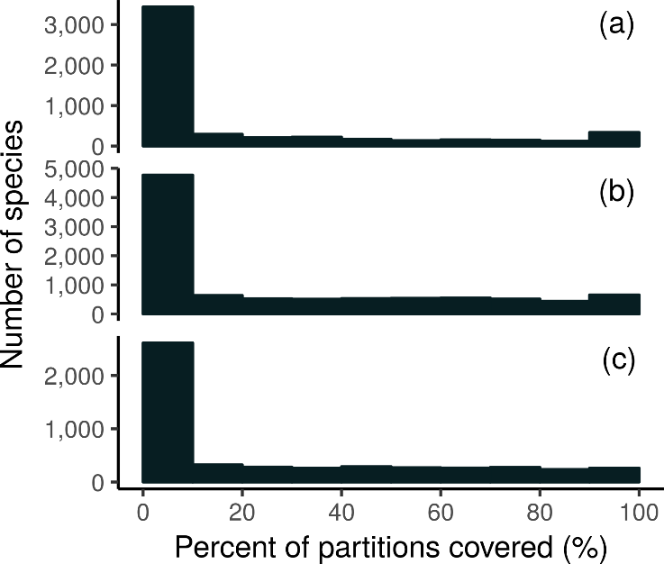
How good is the existing protected system?
Amphibians
18,688 (94%) species are not adequately represented in reserves
8,921 (45%) species do not have a single partition adequately represented
Of these 8,921 species, 2,266 species are globally imperilled
Birds
Mammals

Slide 47
Giant Panda
Local adaptations
in immune system

Slide 48
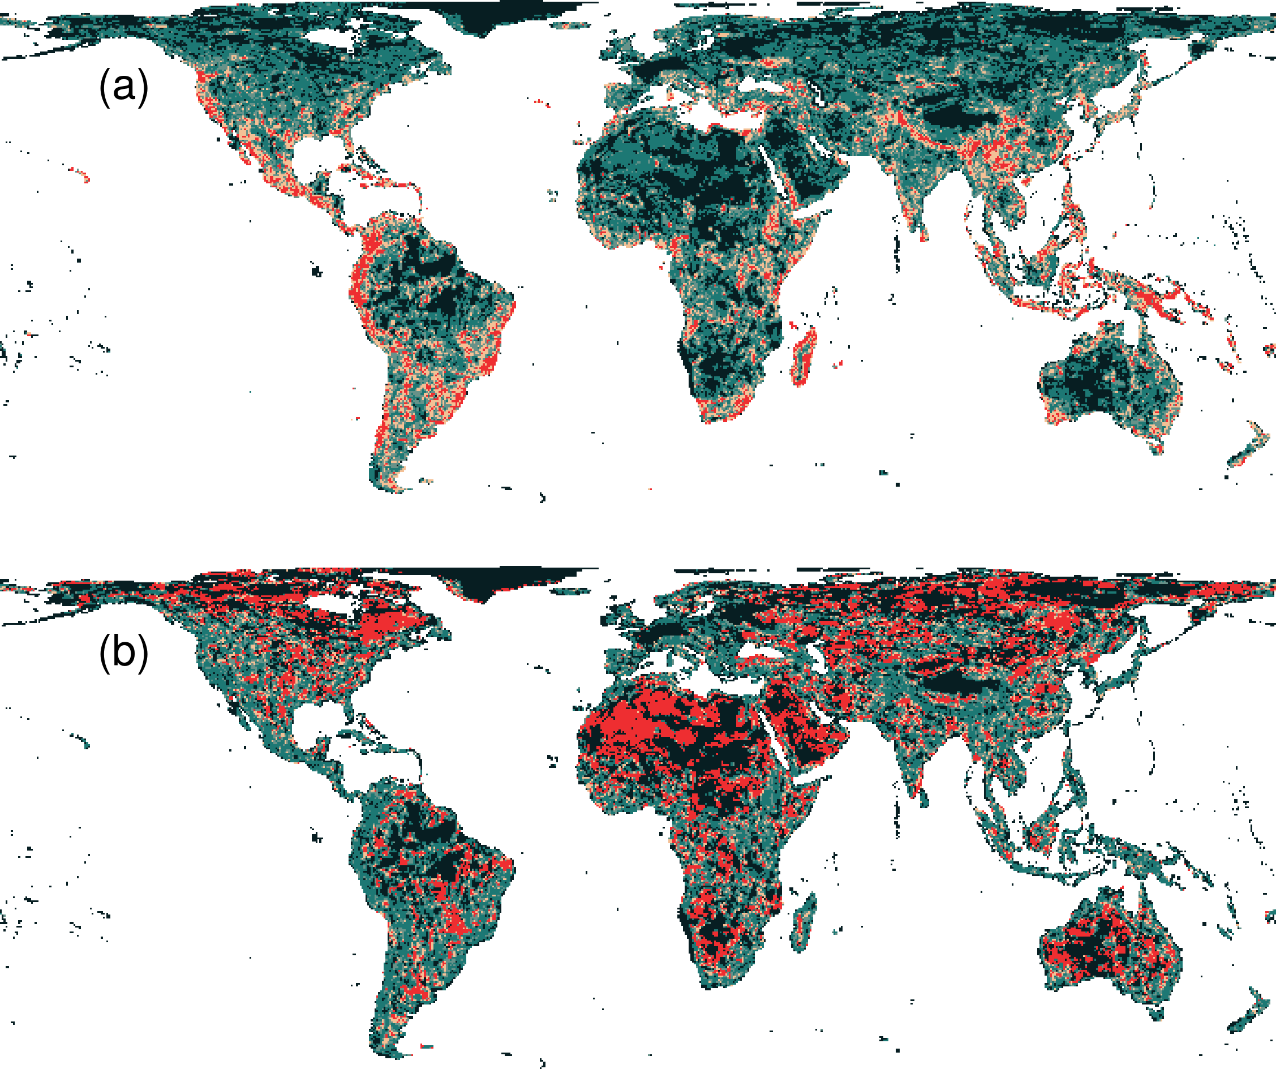
Prioritization for realized niches
35.9 % of the Earth’s land needed to complement existing protected areas
Biodiversity hotspots are critically important
Conservation efforts needed across the planet

Slide 49
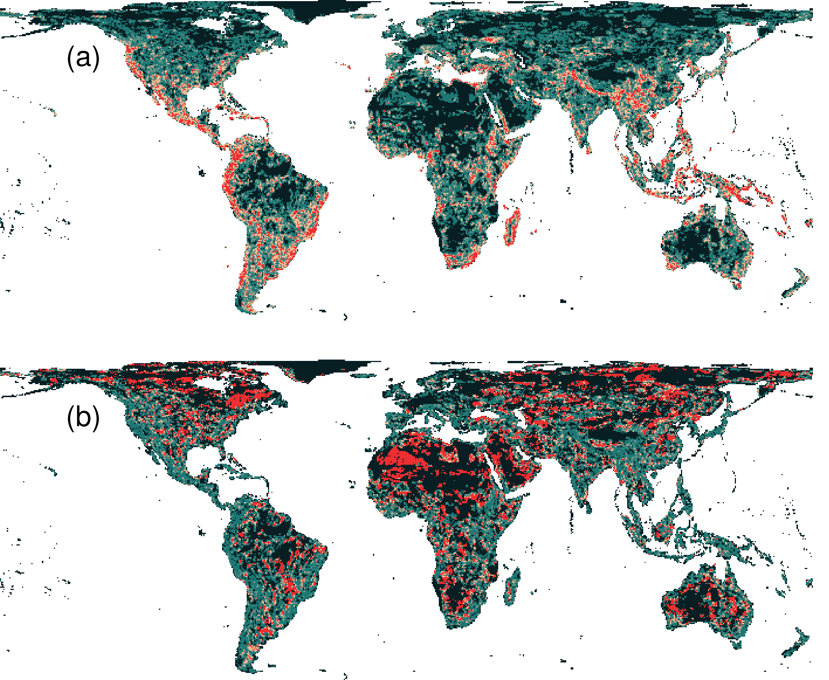
What if we ignore species niches?
Only 3.7% less of the Earth’s land than prioritization which considers niches
Fails to adequately represent 7,989 (40%) species

Slide 50
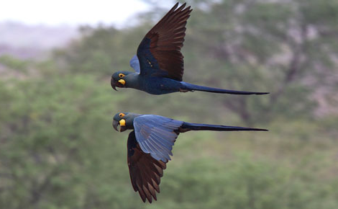
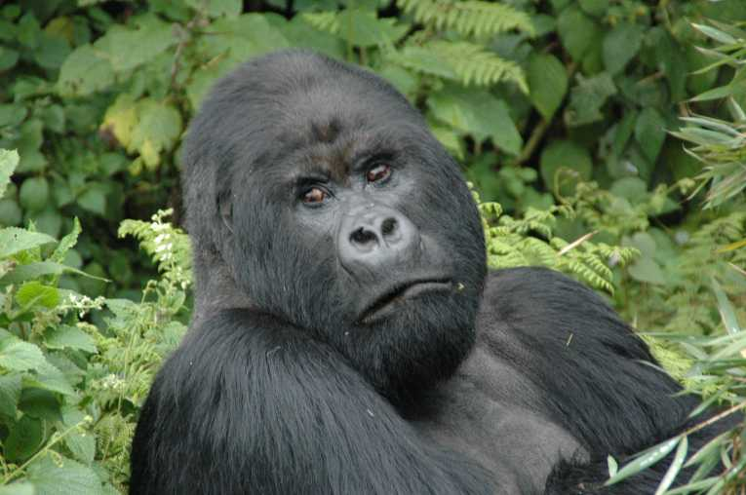
Conservation of realized niches
Current protected area system is insufficient
More protected areas are needed to fill the gaps
Future conservation efforts need to explicitly account for environmental variation

Slide 51

Questions?

Slide 52
Questions?
Frequently asked questions
(answer is always NO)

Slide 53
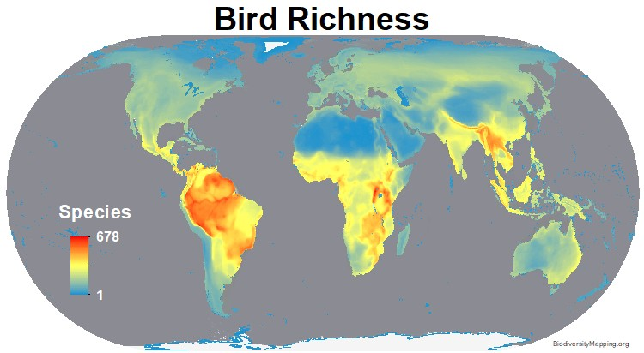
Can’t we just protect places with the greatest species richness/diversity?
Doesn’t account for:
Costs
Species’ requirements
Connectivity
Complementarity
Stakeholder preferences
Previous conservation efforts
https://biodiversitymapping.org
Brown et al. (2015) PNAS, DOI:10.1073/pnas.1509189112

Slide 54
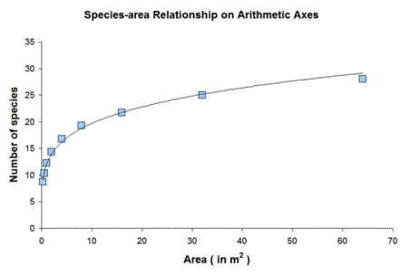
Biogeography says you get more species with larger area, so why not just maximize total amount of land inside protected areas?

Slide 55
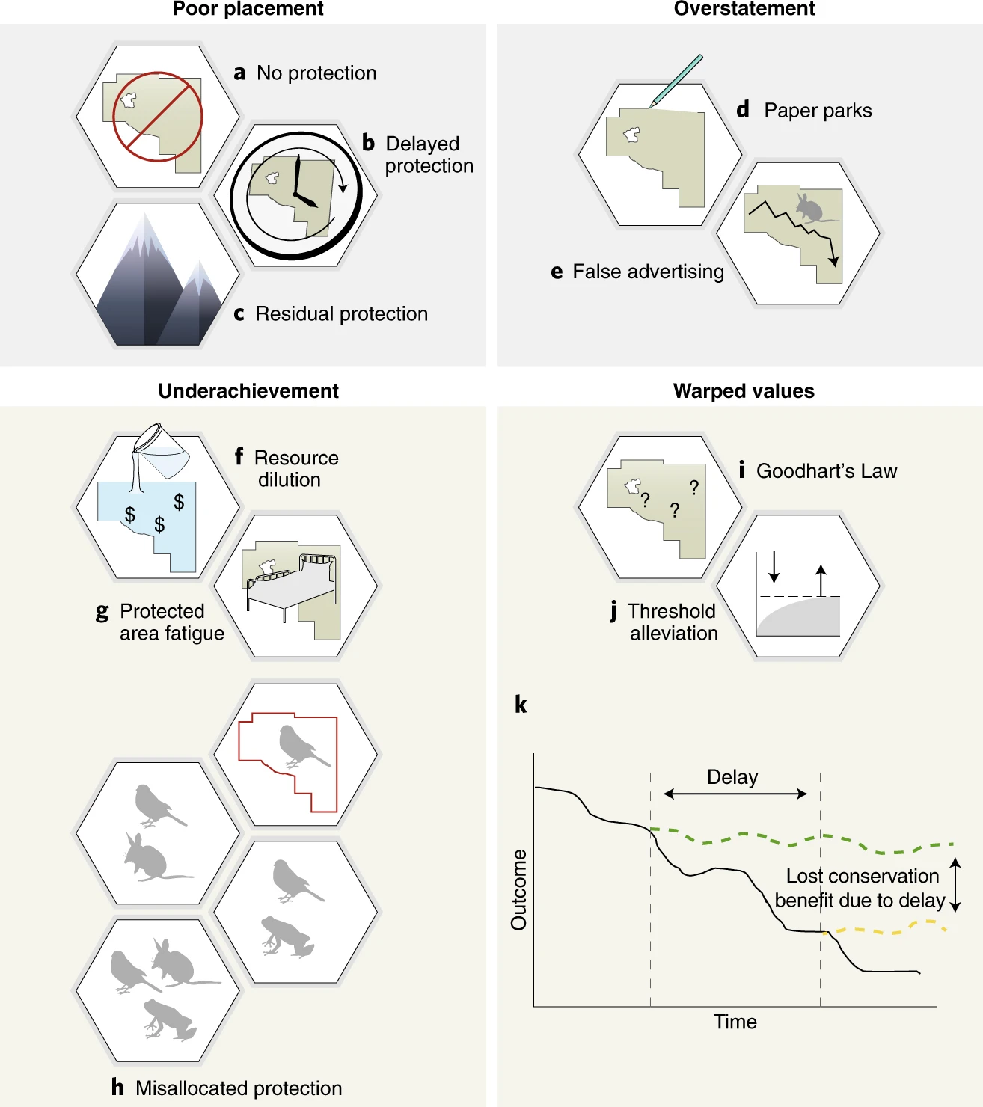
Focussing on protected area size creates perverse incentives
Failure to protect highly threatened, diverse, connected but small areas
Expansion results in delayed protection in areas where protected area (PA) establishment could have had much higher biodiversity benefits
Protection of low-threat, unrepresentative areas, generating limited protective effect
Fails to account for resources allocated to PA management; rewards lack of staff and equipment
Biodiversity losses in a PA remain undetected, but the area is celebrated as ‘protected’
Barnes et al. (2018) Nat Eco Evol, DOI:10.1038/s41559-018-0501-y

Slide 56
Focussing on protected area size creates perverse incentives
Protected area (PA) expansion without associated increases in budget or staff capacity reduces management capacity in situ and across the entire PA network.
PA expansion may induce apathy or resistance to establishing new PAs.
Poorly targeted expansions result […] in actions where biodiversity does not benefit, and limits opportunities for conservation.
Barnes et al. (2018) Nat Eco Evol, DOI:10.1038/s41559-018-0501-y

Slide 57
Focussing on protected area size creates perverse incentives
The real underlying values and objectives of halting biodiversity decline are subsumed by the metric of just protecting more land
As existing protected area coverage targets are thresholds, perceptions of success are binary, failing to account for continual improvements
Any delay or misallocation of limited resources causes long-term harm that may not be reversible at human timescales.
Barnes et al. (2018) Nat Eco Evol, DOI:10.1038/s41559-018-0501-y

Slide 58
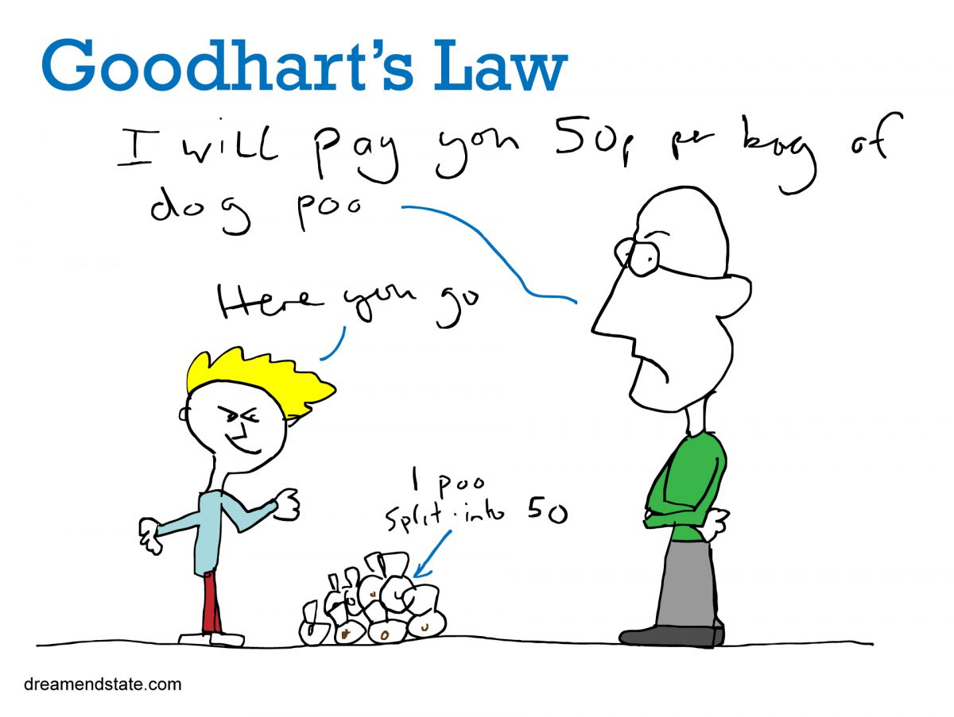
Focussing on protected area size creates perverse incentives

Slide 59
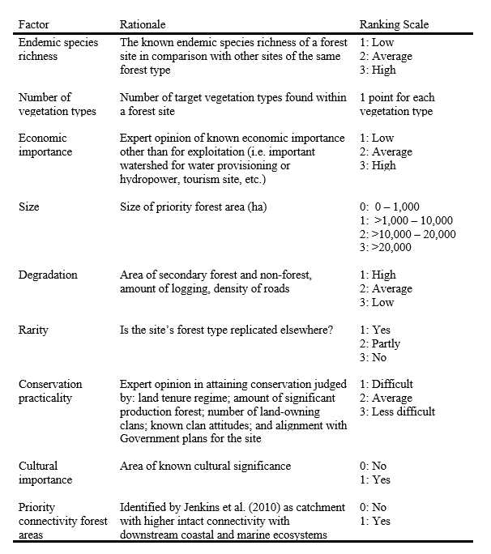
Can’t we just use a scoring system (formula) to rank candidate protected areas?
Game et al. (2013) Cons Biol,
DOI:10.1111/cobi.12051
Klein et al. (2014) Marine Policy,
DOI:10.1016/j.marpol.2013.10.001
Klein et al. (2014) Marine Policy,
DOI:10.1016/j.marpol.2014.03.008

Slide 60
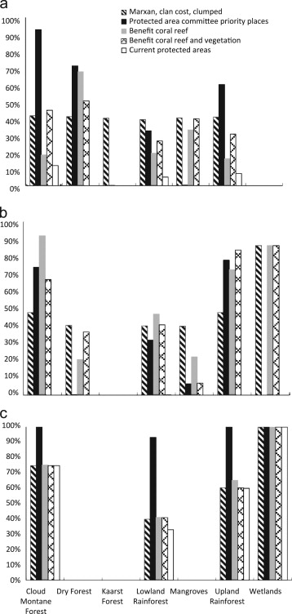
Can’t we just use a scoring system (formula) to rank candidate protected areas?
Plan for protected area network based on systematic conservation planning tool
Proportion of remaining vegetation represented in candidate protected area networks
Plan for protected area network based on scoring system
Representation target
Klein et al. (2014) Marine Policy,
DOI:10.1016/j.marpol.2013.10.001

Slide 61
Can’t we just use a scoring system (formula) to rank candidate protected areas?
Plan for protected area network based on systematic conservation planning tool
Proportion of remaining vegetation represented in candidate protected area networks
Plan for protected area network based on scoring system
Representation target
Klein et al. (2014) Marine Policy,
DOI:10.1016/j.marpol.2013.10.001

Slide 62
Look, I’m sure I could come up with a better formula?
“A major drawback of a listing of priority areas on the basis of a single application of a formula is that there is no guarantee that the priority area second or third on the list might not duplicate the species, communities or habitats that could successfully be preserved in the first priority area.”
Kirkpatrick (1983) Biol Cons, DOI: 10.1016/0006-3207(83)90056-3

Slide 63
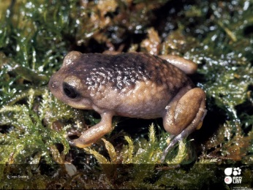


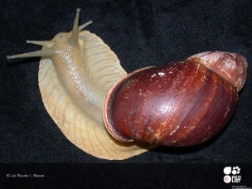
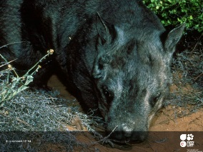
Representation targets don’t seem scientific, can’t the algorithm optimize this for me?
Carwardine et al. (2009), Cons Lett, DOI:10.1111/j.1755-263X.2008.00042.x

Slide 64
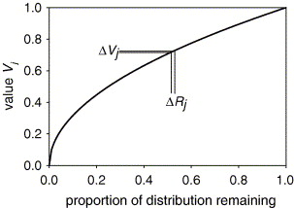
Zonation doesn’t use targets, doesn’t that make it more robust?
Zonation uses trade-off curves to specify (1) how much worse covering X% of a species’ range is than Y%, and (2) how much worse loosing coverage of one species is compared to another
Here now
How bad is removing a certain planning unit?
Moilanen (2007) Biol Cons, DOI:10.1016/j.biocon.2006.09.008

Slide 65
Zonation doesn’t use targets, doesn’t that make it more robust?
1
Examples of different trade-off curves:
Rare species
Generalist species
Culturally important species
Only going below 5% coverage causes
steep drop
Fairly steady decrease in performance with reduction in coverage
Value
Going below ~90% coverage causes steep drop in performance
0
0%
50%
100%
Proportion of distribution remaining

Slide 66
You really think people will listen to a computer?
Systemic conservation planning helps:
support decision making – it doesn’t make decisions or dictate them
identify priority areas (just because the algorithm doesn’t say a place is a priority doesn’t necessarily mean it’s not important!)
facilitate discussions between stakeholders by navigating trade-offs
land-use and sea-scape planning by considering multiple zones (e.g. prioritizing places for recreational fishing and conservation)
real-world decision making, such as Great Barrier Reef (Australia), Gulf of California (USA), Cape Floristic Region, (South Africa), and marine planning (Montserrat)
Cowling et al. (2003) Biol Cons, DOI:10.1016/S0006-3207(02)00425-1
Álvarez-Romero et al. (2013) Aquatic Conserv, DOI:10.1002/aqc.2334
Fernandes et al. (2005) Conserv Biol, DOI:10.1111/j.1523-1739.2005.00302.x
Flower et al. (2020) Conserv Sci Prac, DOI:10.1111/csp2.158

Slide 67
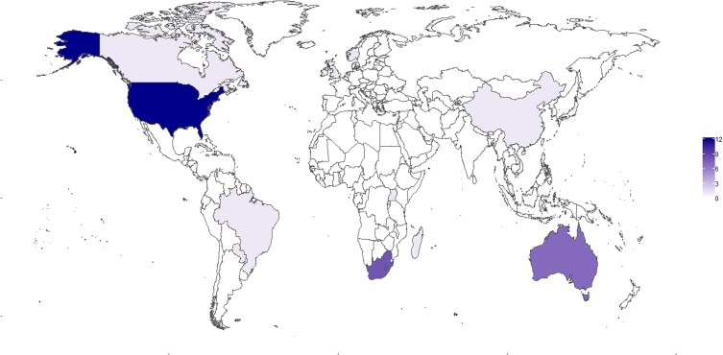
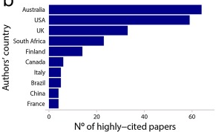
Isn’t conservation planning just something Australian’s do?
N° of highly-cited papers, based on study area
Ribeiro & Atadeu (2019) J. Nat. Conserv., DOI:10.1016/j.jnc.2019.125714

